Slide 1

MINI PROJECT ON PATHOLOGY IMAGE ANALYSIS FOR LUNG CANCER CLASSIFICATION USING IBM WATSON SUBMITTED BY: B.VAMSHI KRISHNA (18UK1A05J3) G.SAI PRANITHA (18UK1A05K1) CH.SRINISH REDDY (18UK1A05H1) M.PRADEEP REDDY (18UK1A05F3)

Slide 2
INTRODUCTION:
Lung cancer is one of the causes of cancer deaths. It is difficult to detect because it arises and shows symptoms in final stage. However, mortality rate and probability can be reduced by early detection and treatment of the disease. Best imaging technique CT imaging are reliable for lung cancer diagnosis because it can disclose every suspected and unsuspected lung cancer nodules. However, variance of intensity in CT scan images and anatomical structure misjudgement by doctors and radiologists might cause difficulty in marking the cancerous cell. Recently, to assist radiologists and doctors to detect the cancer accurately computer Aided Diagnosis has become supplement and promising tool. There have been many systems developed and research is going on detection of lung cancer.

Slide 3
ABSTRACT:
The main objective of this project is to detect whether the tumor present in a patient’s lung is malignant or benign using Convolution Neural Network (CNN) .
In a study published in Nature Medicine, researchers said that lung cancer caused an estimated 160,000 deaths in 2018, making it the most common cause of cancer death in the US. Lung cancer screenings that use low-dose tomography have been shown to reduce mortality by 20-43 percent, but there are still challenges that result in unclear diagnoses, subsequent unnecessary procedures, and high costs. Radiologists also usually have to look through dozens of 2D images within a single CT scan, and cancer can be hard to spot. Deep learning can offer a viable solution to these problems.

Slide 4
DEFINITION:
Lung cancer is the most dangerous and widespread cancer in the world according to stage of discovery of the cancer cells in the lungs, so the process early detection of the disease plays a very important and essential role to avoid serious advanced stages to reduce its percentage of distribution.

Slide 5
Objective of Project :
The goal of a CT screening program is to detect early lung cancer and facilitate curative treatment; however, primary prevention through smoking cessation or never starting is the best means to reduce the risk of dying of lung cancer. We need to get the word out to those at high risk who stand to benefit most from mortality reduction.

Slide 6
Existing problem:
People with an increased risk of lung cancer may consider annual lung cancer screening using low-dose CT scans. Lung cancer screening is generally offered to people 55 and older who smoked heavily for many years or who have quit in the past 15 years.Disadvantage of existing system.The existing system is Time consuming process, and it's very difficult to detect.

Slide 7
Proposed Solution:
CNN model is proposed with boosted accuracy to predict the lung cancer patient. The framework is composed of the following important phases:
Dataset Collection(Creating training and testing folders)
Image preprocessing
Model building
Application building
Train the model on IBM

Slide 8
The network is implemented as a class called CNN. It contains two main methods. The first method (__init__) defines layers components of the network. In the second method we wire the network and put every component in the desired order. The python code below is straightforward. The network is defined using the neural network module of Torch. Notice that we already choose hyper-parameters of the network, such as Padding (P), Stride (S) and Kernel size (F). Also the number of filters at each layer. The input image has four dimensions.
IMPLEMENTATION:

Slide 9
DATASET:
A set of real patient CT scan images are obtained from the Lung Image Database Consortium (LIDC) archive is used in this analysis. LIDC database contains lung cancer screening CT images for development, training, and evaluation of computer-assisted diagnostic methods for lung cancer detection and diagnosis. The National Cancer Institute initiated it. It consists of 1018 cases of dataset contributed by seven academic and eight medical imaging companies. Using Computed-Tomography (CT) images to ensure early diagnosis of lung cancer and differentiation between benign and malignant tumours has developed computer-Aided Diagnosis (CAD) system. Computer-Aided Diagnosis (CAD) can be helpful for doctors to identify cancerous cells accurately.

Slide 10
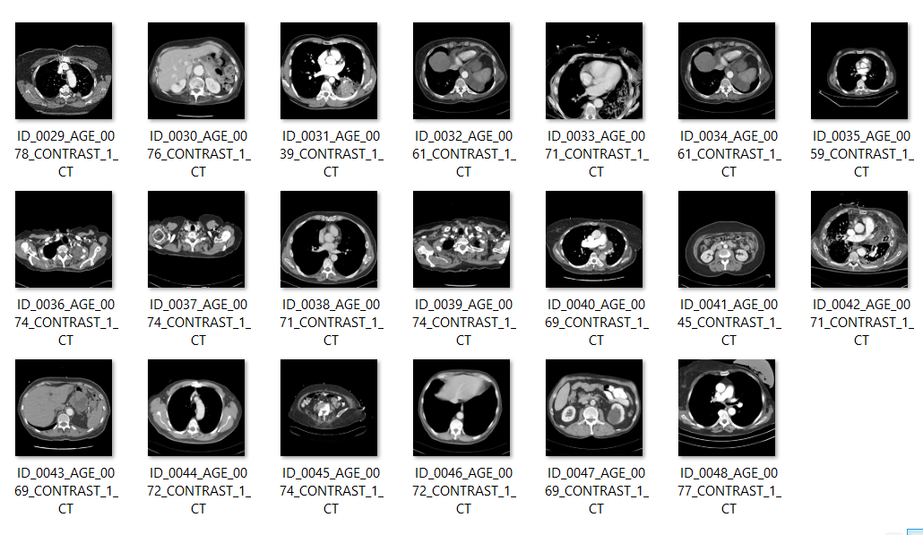
Cancer Train Dataset

Slide 11
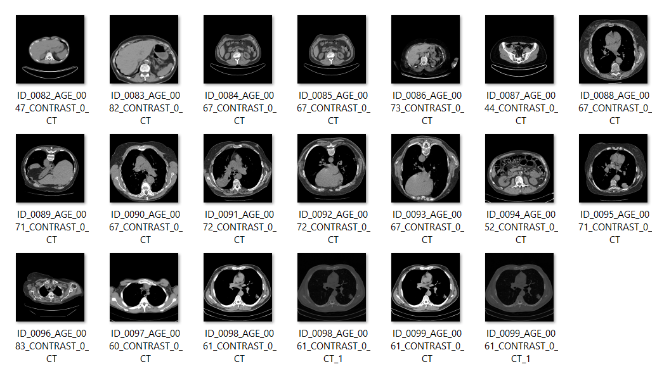
Non Cancer Test Dataset

Slide 12
ADDING CNN LAYERS:
We are adding three layers for CNN
Convolution Layer,
Pooling Layer,
Flattening Layer
Dense Layer

Slide 13
Convolutional Layer: The convolutional layer is the first and core layer of CNN. It is one of the building blocks of a CNN and is used for extracting important features from the image. Pooling Layer: Pooling reduces the dimensionality of images by reducing the number of pixels in the output from the previous convolutional layer. It helps us to avoid over-fitting of data. Flattening Layer: Flattening layer converts the multi-dimension matrix to one single. Dense Layer: Each neuron in a layer receives input from all the neurons present in the previous layer. Dense is used to add the layers

Slide 14
CONCLUSION
In this study we have proved that it is feasible to build highly accurate malignancy classifiers relying on deep learning techniques to predict nodule malignancy. We have validated that they are also good predictors of lung cancer at the patient level when having the location of nodules beforehand. In order to provide a more realistic evaluation of nodule.

Slide 15

OUTPUT

Slide 16
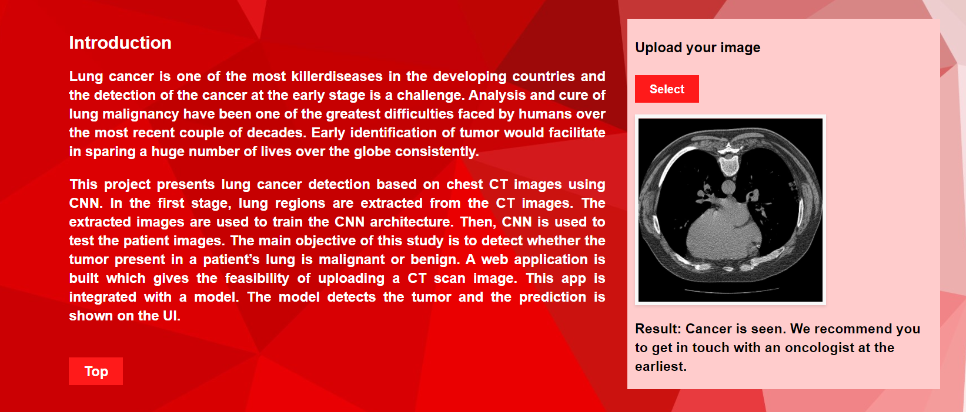
OUTPUT

Slide 17
THANK YOU

